Slide 1
Office 365 Development
July 2014

Slide 2
Course Agenda
Introduction to Office 365 Development
Module 1: Overview of Office 365 Development
Module 2: Getting started with Apps for Office
Module 3: Getting started with Apps for SharePoint
Module 4: Getting started with the Office 365 APIs
Module 5: Getting started with Mobile development with Office 365
Module 6: Moving Full Trust Code to the Cloud Using Repeatable Patterns and Best Practices
Module 7: Setting up your Developer environment in Office 365
Module 8: Setting up your on-premises environment for app development

Slide 3
Getting started with Mobile development with Office 365
Jeremy Thake
Technical Product Manager, Microsoft
Scot Hillier
SharePoint MVP, Scot Hillier Technical Solutions, LLC

Slide 4
Agenda
Intro
Microsoft Platform
Non-Microsoft Platforms
Multi-platform
Notes:
What new APIs are available, in preview, in the Office 365 Platform
How to use these API’s in your platform of choice
Some sample business scenarios for leveraging these API’s
Level: Intermediate
Audience: Developer Essentials

Slide 5
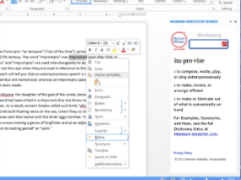
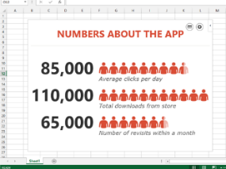
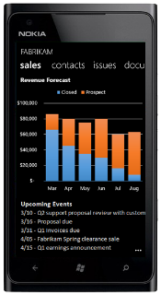
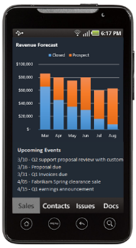
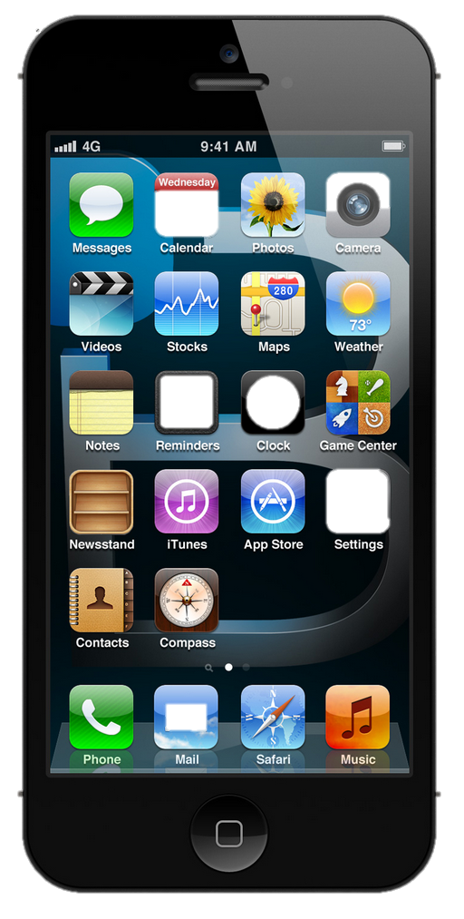
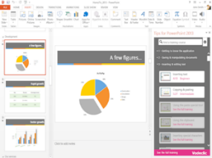
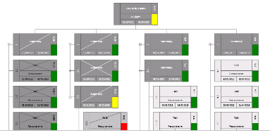


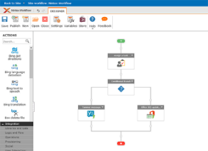



The new Office development platform
Contextual apps
Robust APIs
Flexible tools
iOS
Documents
Search
Mail
Social
Calendar
People
Notes:
Two kinds of apps :
you light up Office/Exchange/SharePoint.
You consume our services in a custom (device or web) app
Contextual apps
Rich, powerful interactive IW experiences
Do more, without leaving Excel, Outlook, PowerPoint, SharePoint
Consistent Framework everywhere that Office runs. Everywhere that people do work
Robust APIs
Big news
More for SharePoint Devs
Growing up outside SharePoint
Flexible Tools
Open-ness and choice is a core pillar
But … we just want to take away all the friction
Tools targeted to specific users
Platforms with best management, capability and scale
What does this mean. Where is the value
Breadth : more endpoints and experiences
Depth: richer APIs. More capabilities
Power:

Slide 6
Intro
Getting started with Mobile development with Office 365

Slide 7
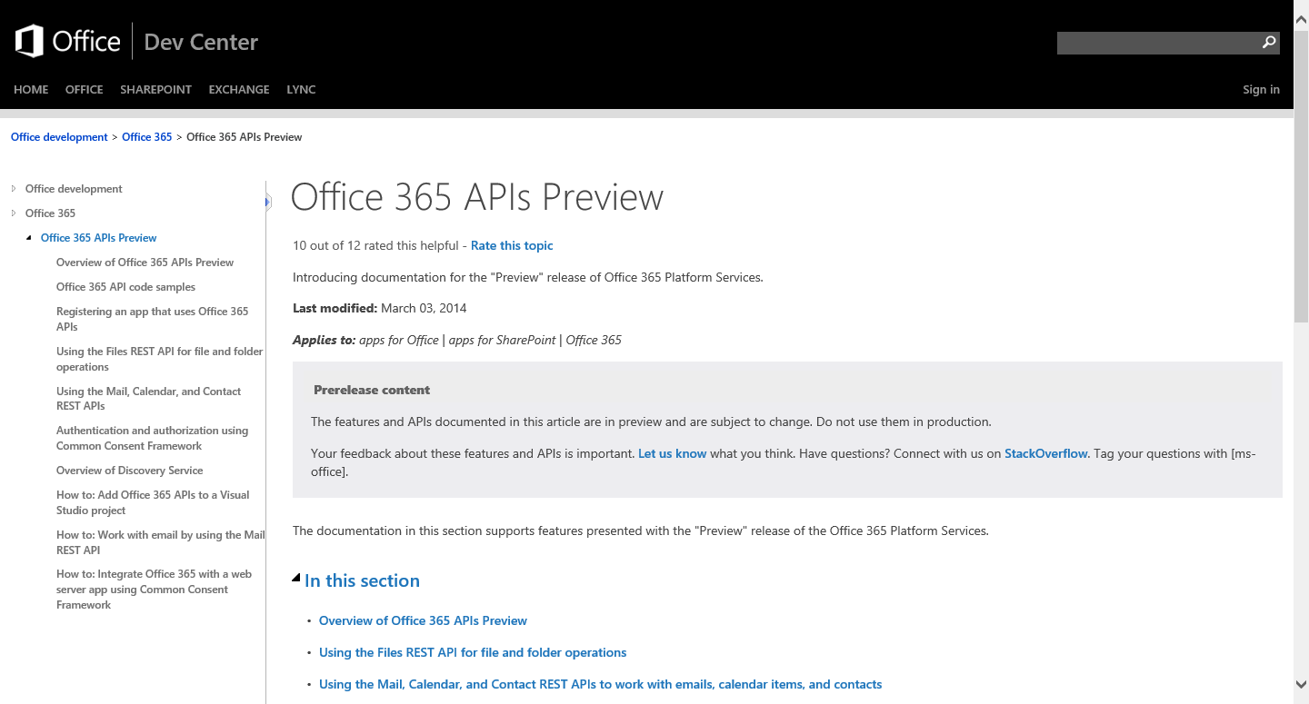
http://aka.ms/Office365DevAPIs

Slide 8
Microsoft Platform
Getting started with Mobile development with Office 365

Slide 9
demo
WINDOWs 8

Slide 10
Native Platforms
Getting started with Mobile development with Office 365

Slide 11
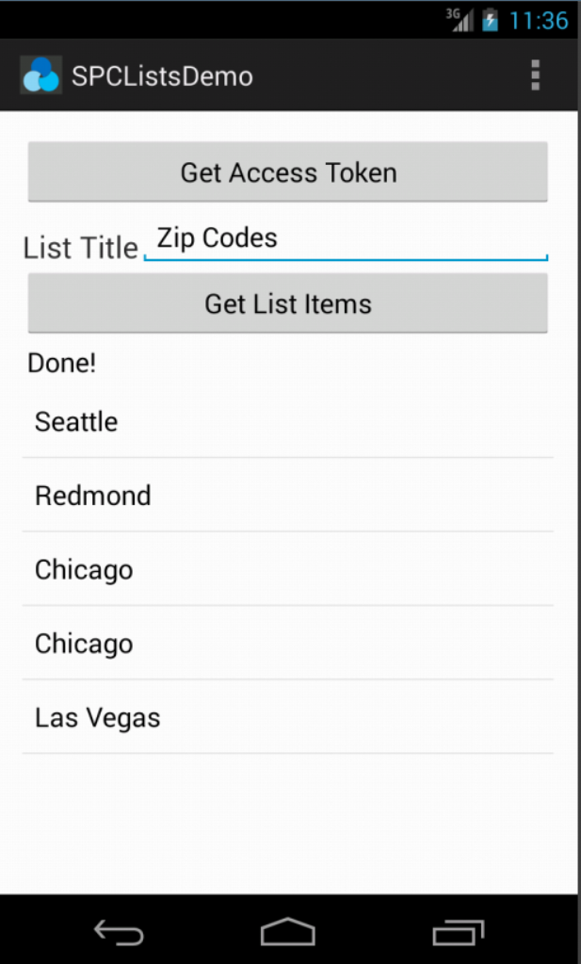
Office 365 SDK for Android
Available today on GitHub
SDK for native Android apps that use Office 365 APIs
Handles files, lists, mail, and calendar
Integrates with AD authentication library

Slide 12
demo
ANDROID

Slide 13
Office 365 SDK for iOS

Slide 14
demo
iOS

Slide 15
Multi-platform
Getting started with Mobile development with Office 365

Slide 17
demo
Cordova

Slide 18
demo
XAMARIN

Slide 19
Wrap Up
XXXX

Slide 20
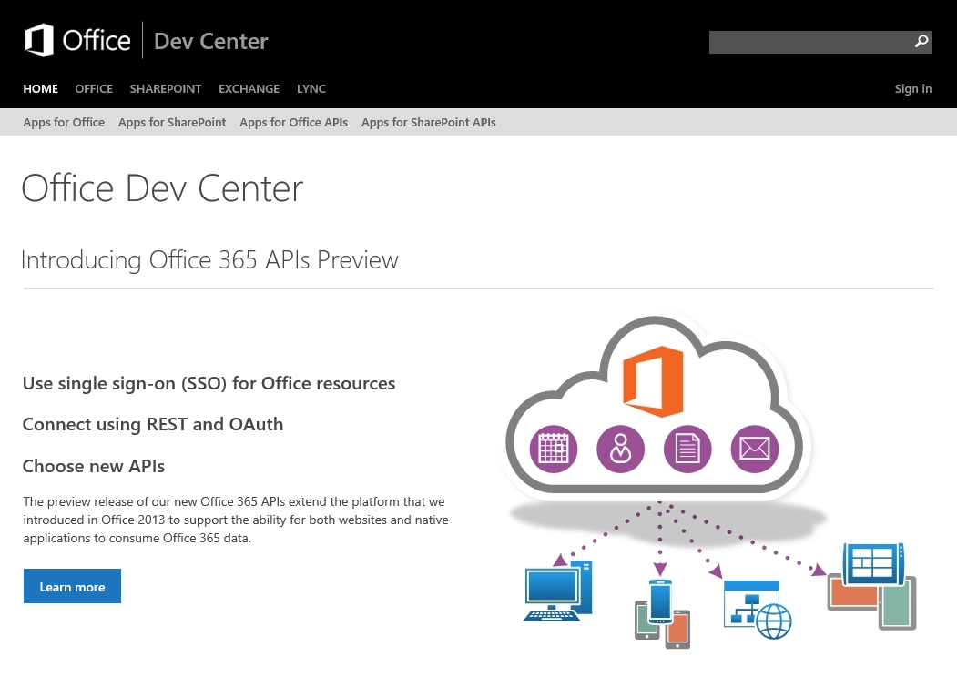
Dev.
Office
.com
One stop shop for Office Developer Platform

Slide 21


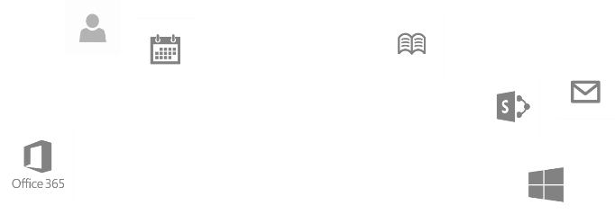
Calls to action
Explore our MSDN library
http://dev.office.com
Play with our code samples
http://aka.ms/OfficeDevSamples
Follow our patterns & practices
http://aka.ms/OfficeDevPnP
Get answers
http://aka.ms/AskSharePoint
http://aka.ms/AskOffice
Give feedback Drive our roadmap http://aka.ms/OfficeDevFeedback

Slide 22
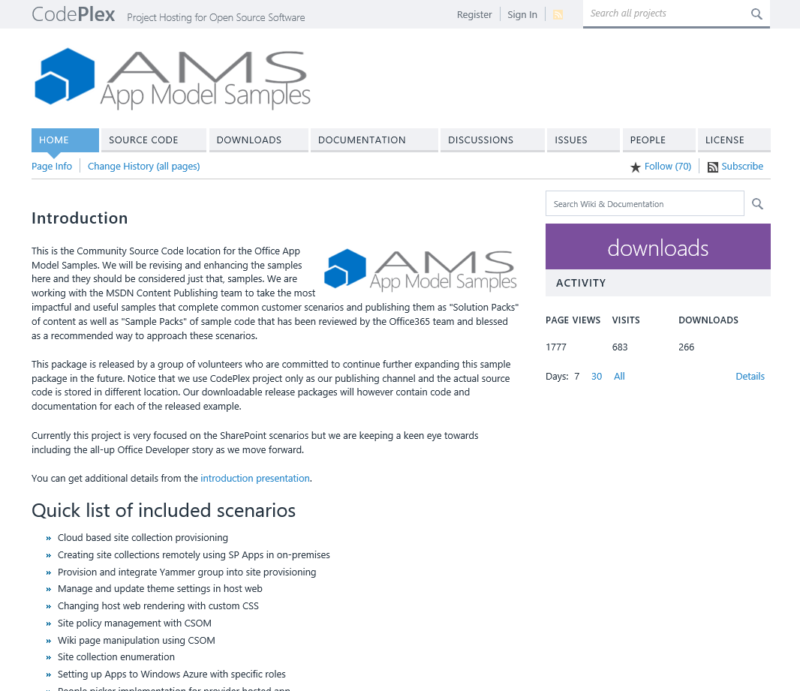
aka.ms/OfficeAMS
Patterns and practices
Providing App Model Patterns for common Full Trust Code scenarios
30+ Visual Studio projects Common scenarios
Branding
Site provisioning
Remote event receivers
Large file support
Taxonomy driven navigation
And much more…
Contribute
Open source coming soon!

